Slide 1
BIS 403 – Applied Systems Design
Week 6 – Chapter 9 Case Study Peirce College Professor: Robert Heubner
Case Study: Personal Trainer
Teammates: J. Sherif and M. Morrison
Date: 02/19/2024
Tasks: 1 & 2 are completed by J. Sherif
Tasks: 3 & 4 are completed by M. Morrison

Slide 2
Normalization in Data Design Context
Creating table designs by assigning specific fields or attributes
Involves identification of a primary key in a table
A process for avoiding problems in data design
Normalization stages: • Unnormalized design
Aka raw data or non-first normal form
A table with repeating groups

Slide 3
Normalization in Data Design Context (ctd)
• First Normal Form (1NF)
Elimination of repeating group
Inclusion of primary key of the repeating group
• Second Normal Form (2NF)
Functional dependency of all fields after 1NF
• Third Normal Form (3NF)
Redundancy avoidance after 2NF

Slide 4
Personal Trainer - ERD
Instructor
Name
Schedule
Trains
Name
Email
TRAINEE
Address
Buys
Takes
Merchandise
CLASS

Slide 5
Personal Trainer Database Design
The Following Four Slides give a brief visual representation of the various tables that will be utilized to store company data & information.
Primary & Foreign Keys will be utilized to promote 3NF as well as provide links to other tables via Join queries.
Microsoft SQL Server will be hosted within AWS, relevant databases will be created with relevant tables to promote organization and ease of use.
Example data will be presented for three of the tables.

Slide 6
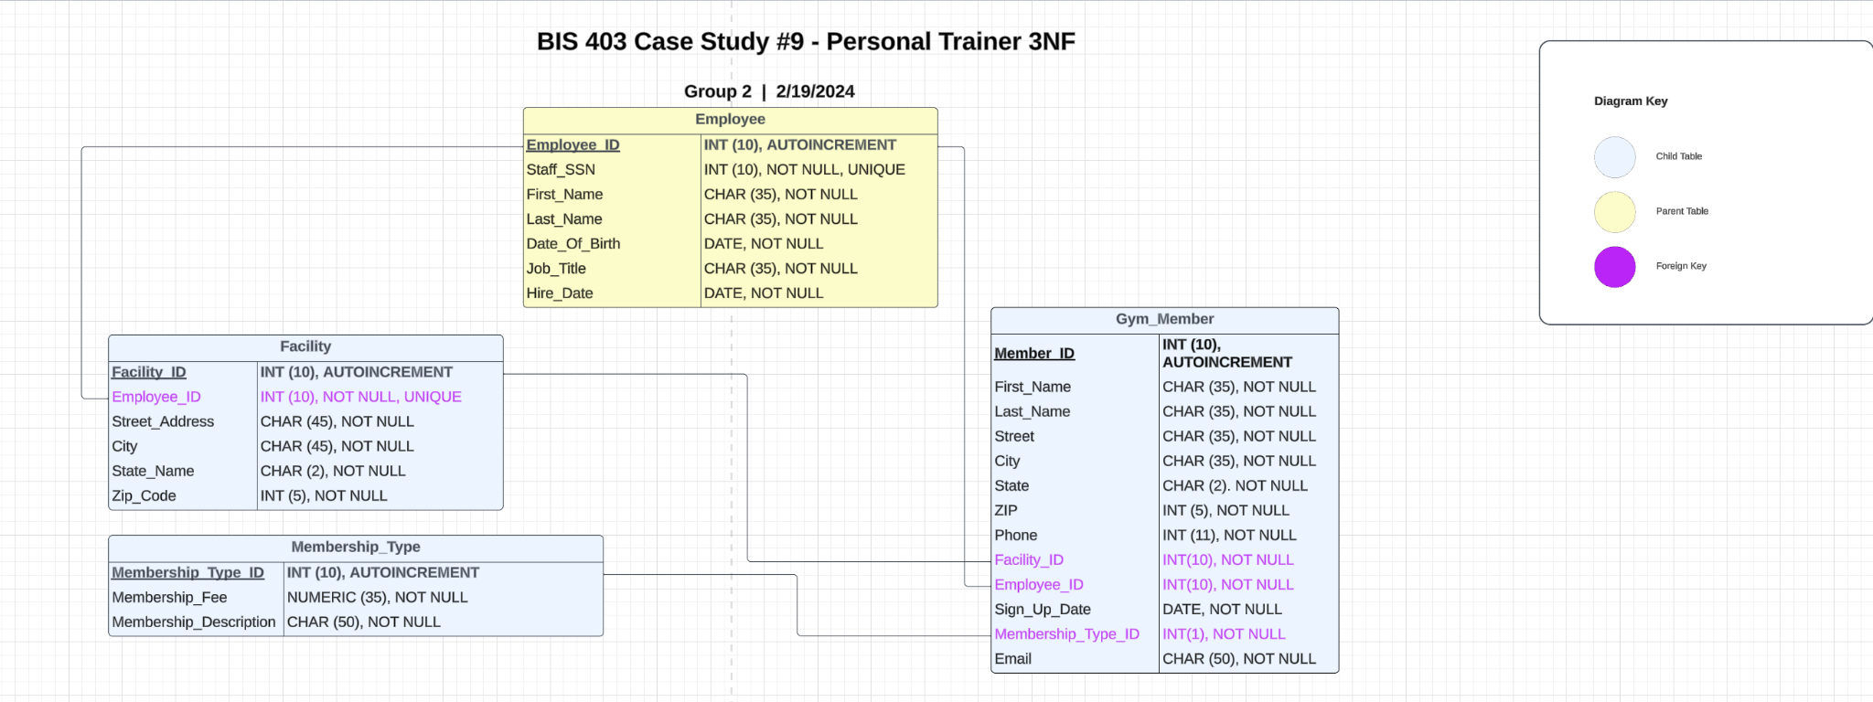
Personal Trainer 3NF Database Design

Slide 7
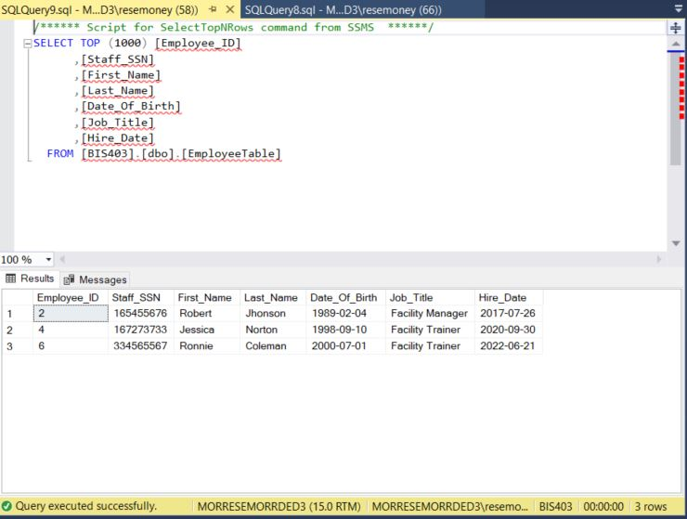
Personal Trainer 3NF Database Design (Employee Table SQL Screenshot)

Slide 8
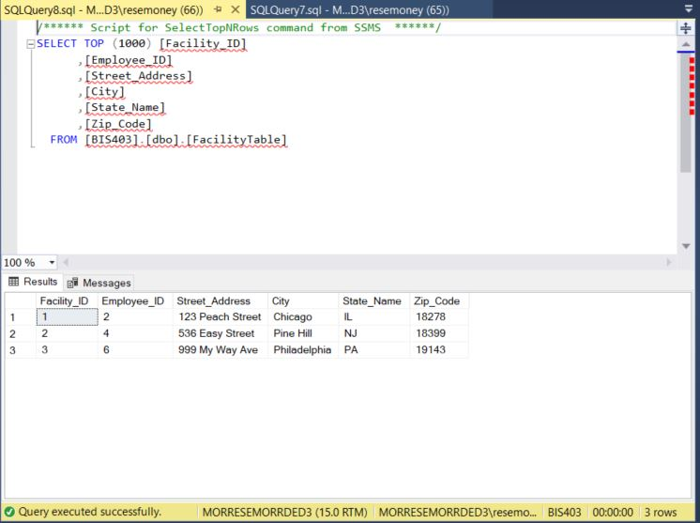
Personal Trainer 3NF Database Design (Facility Table SQL Screenshot)

Slide 9
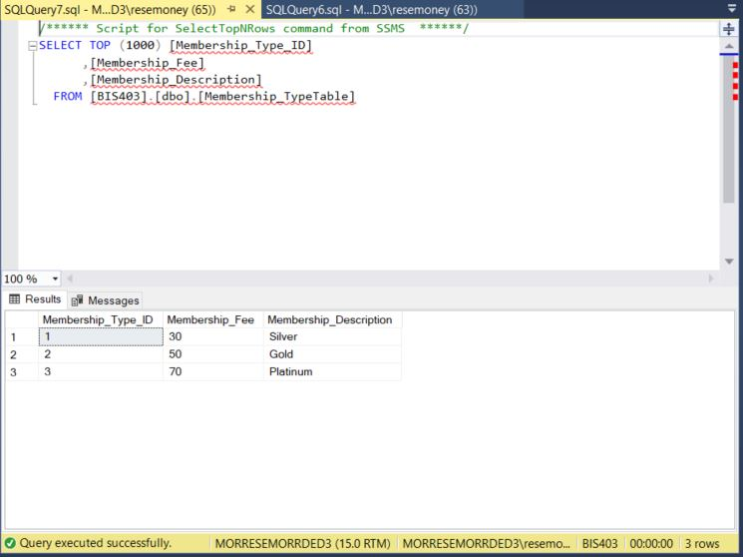
Personal Trainer 3NF Database Design (Membership Type Table SQL Screenshot)

